Slide 1
Twitter Disaster Detection
The warning app
by
Julia
Markus
Peter

Slide 2

Task
Build a model which is capable of correctly classify tweets as either disaster tweets or false alerts

Slide 3
Strategy
data exploration
clean keywords
transform text via NLP techniques
perform different ML approaches to find best differentiator model
build app using a ML pipeline to predict alert situations

Slide 4
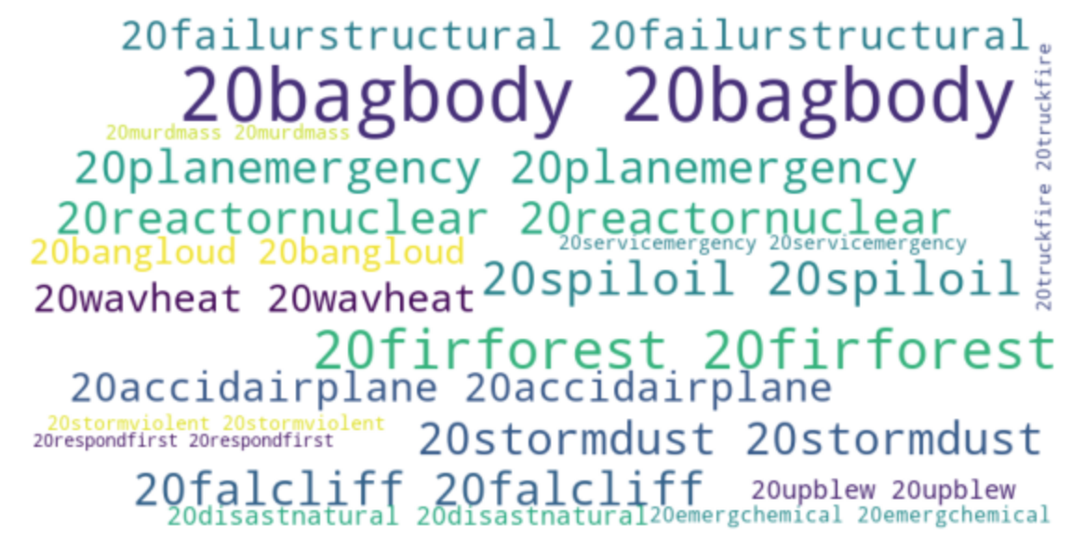
Workbench
Day 1:
Setup strategy, git project (group)
data wrangling ( group)
NLP basics (group)
first prediction (group)

Slide 5
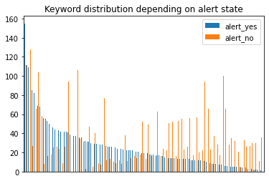
Workbench
Day 2:
find best pipe to predict real and false alerts (individual)
visualize keyword distribution depending on alert state (individual)
programming warning app for users (individual)
Beispiel: Keywords analytics by Peter

Slide 6
Workbench
Day 3:
Git (group)
different NLP and ML techniques ( group)
many different models tested
Markus mit großen Tabellen + einer Live Prediction

Slide 7
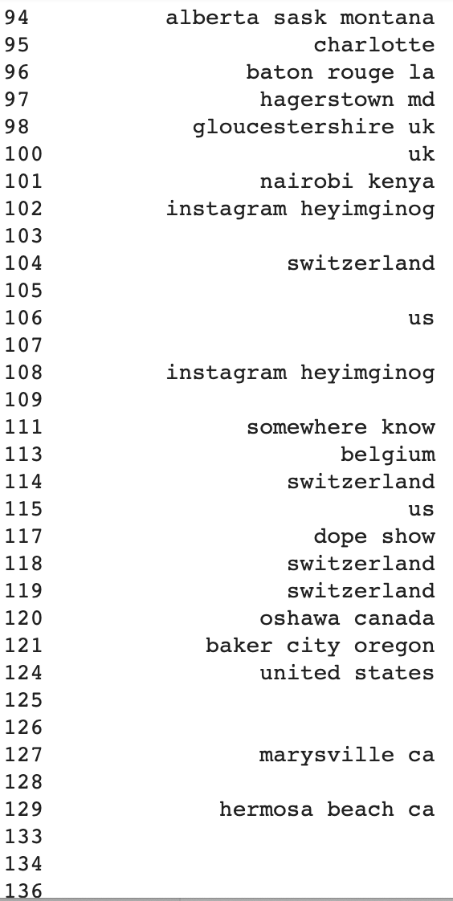
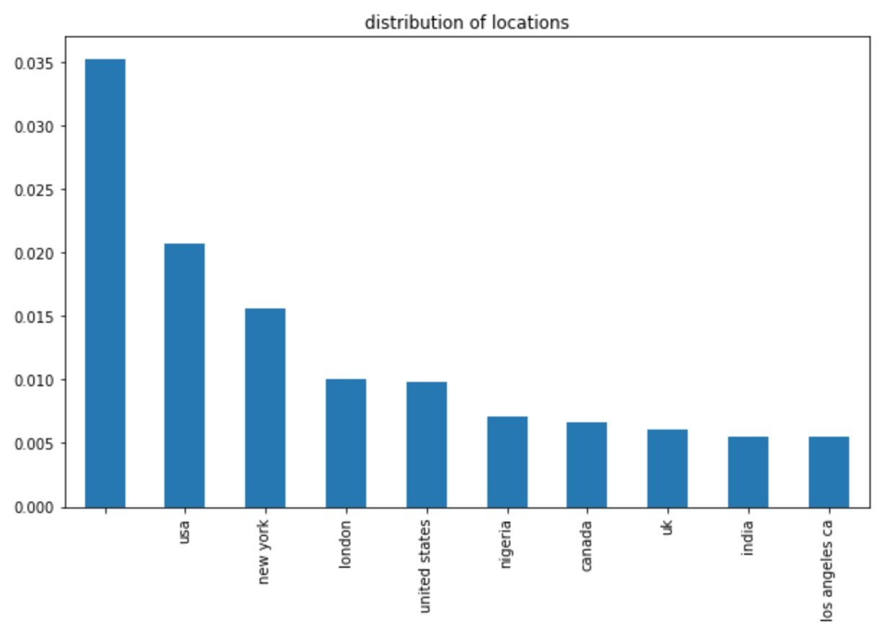
Workbench
Day 4: df['location_clean']
No Value

Slide 8
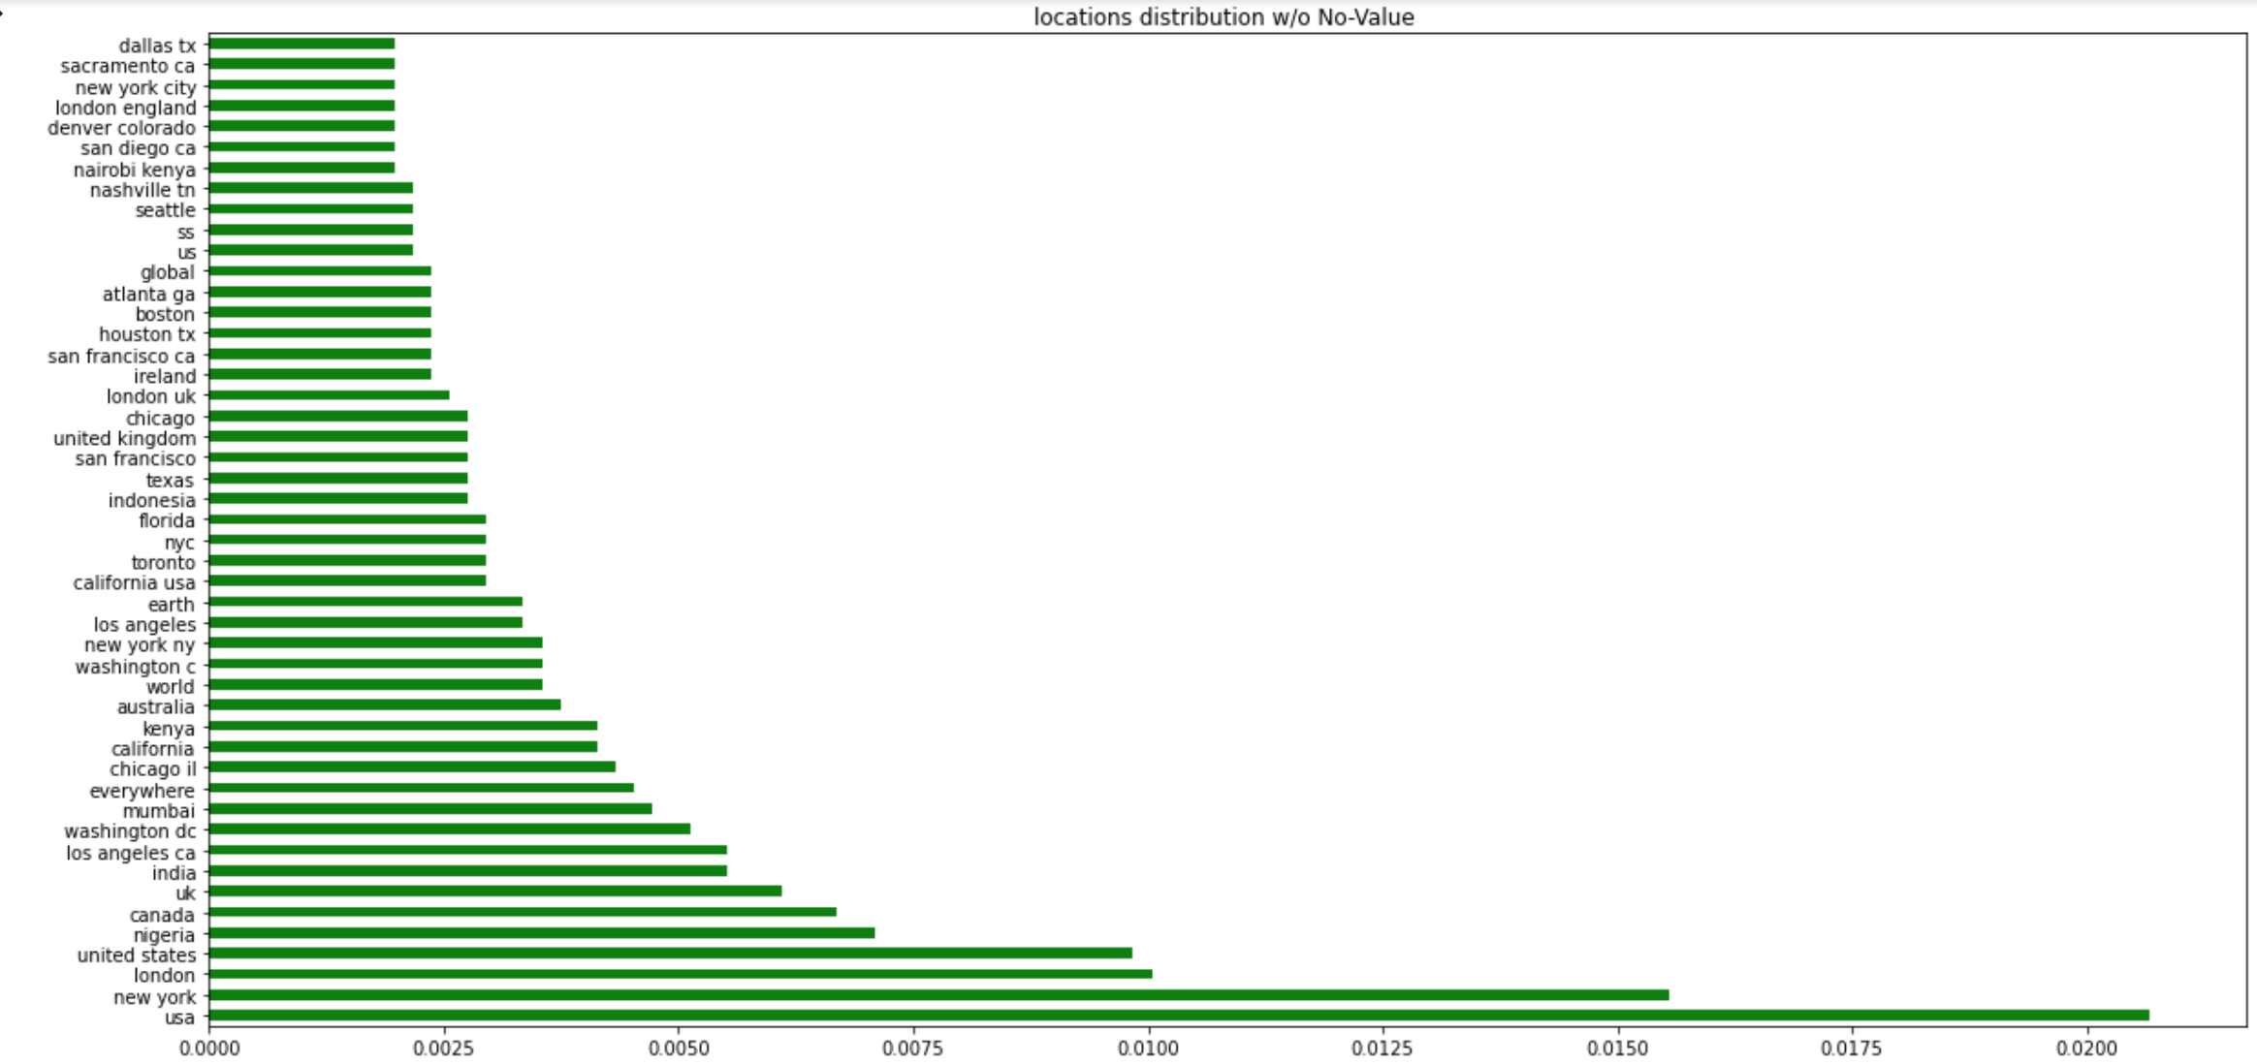
Workbench
# cleaning: df.replace("[^a-zA-Z' ]“).split().lower().re.findall().stopwords.

Slide 9
Workbench
2674 hkxfymhex
2675 hamilton county in
2676 dakar
2677 in your head
2678 the sanctuary network rome
2679 tractor land aka bristol
2680 adventuring in narnia
2681 asgard
2682 unite bless wallahi
2683 sneaking glances at thancred
2684 ljp
2685 charlotte north carolina
2686 nirvana
2687 ny
2688 mentor oh
2689 trumann arkansas
2690 cc
2691 d sos ag
2692 pa usa
2693 m k a d
2694 pissing off antis
2695 'san antoniooooo'
# cleaning: df.replace("[^a-zA-Z' ]“).split().lower().re.findall().stopwords.

Slide 10
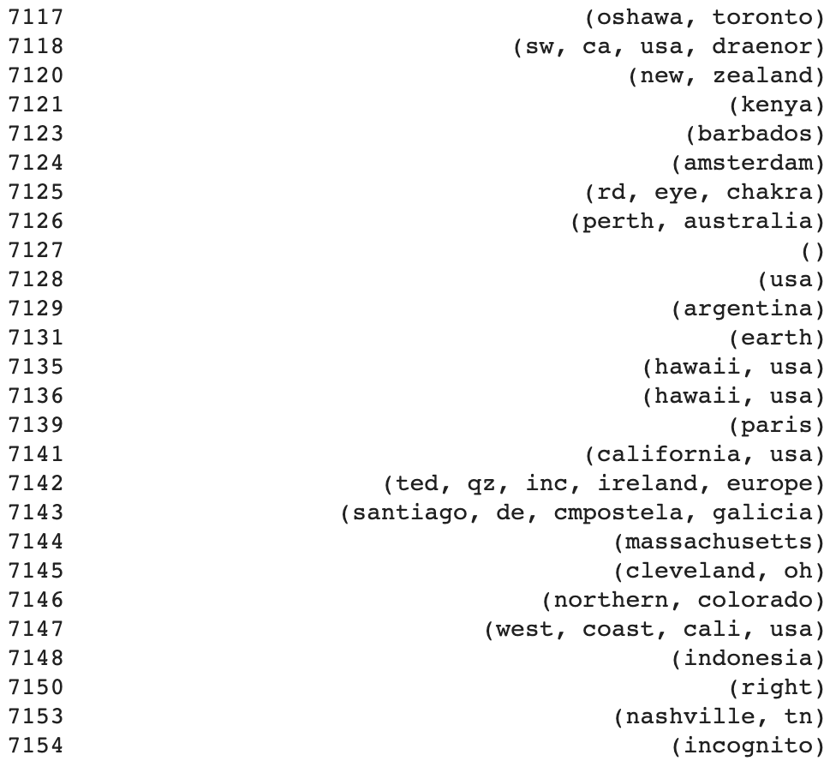
Workbench
doc_loc =df['location_clean'].apply( lambda satz: nlp(satz) )

Slide 11
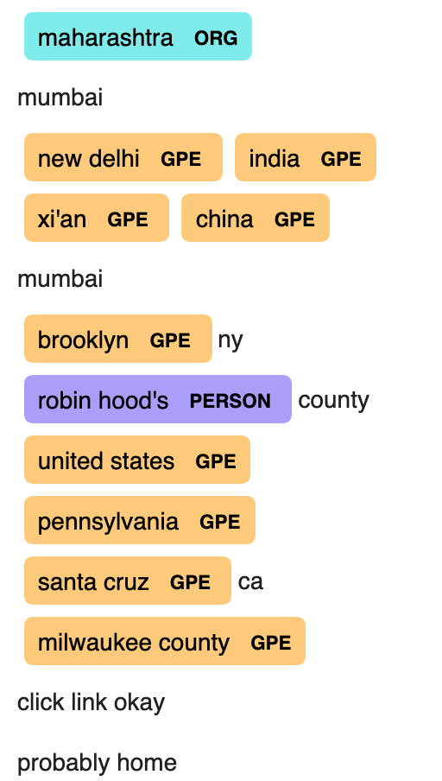

Finde den Fehler
displacy.render(doc_loc, style="ent", jupyter=True)

Slide 12
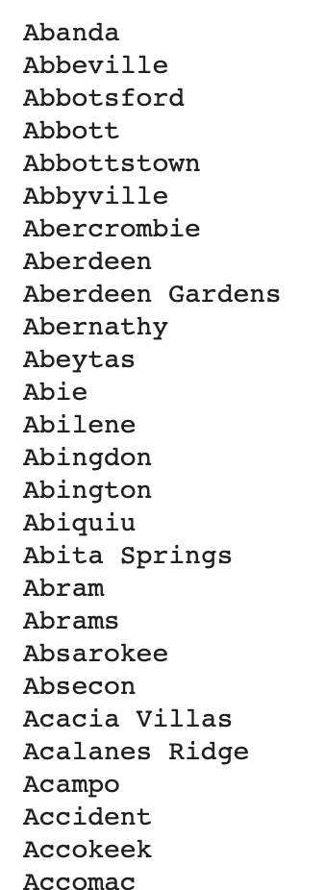
Finde in Stadtliste
https://www.mithrilandmages.com/utilities/CityBrowse.php
Explorative Datenanalyse
Original Data:
5080
Number of locations with True Alert (1)
1328
Number of locations with False Alert (0)
1898
All data with a locations
2895
if string is in cities_list: location_list.append()

Slide 13
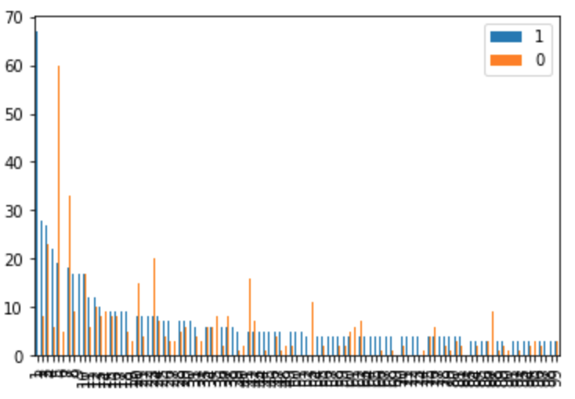
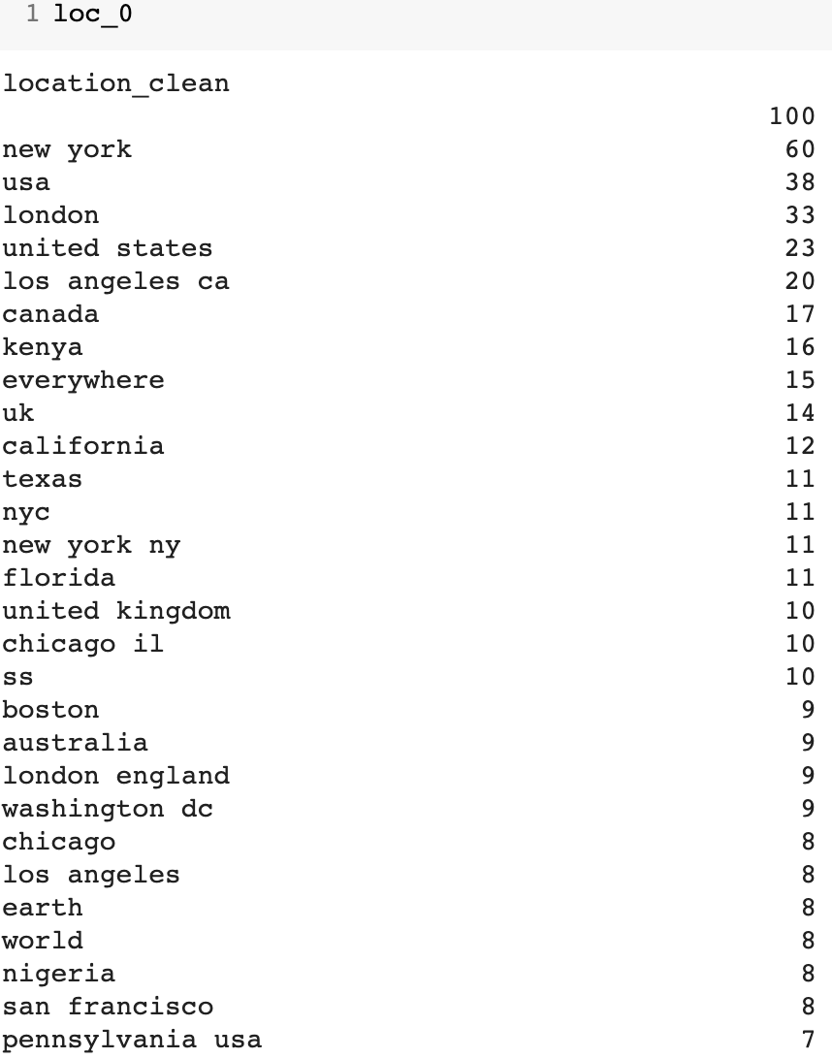
Führt zu sauberen Listen - only

Slide 14
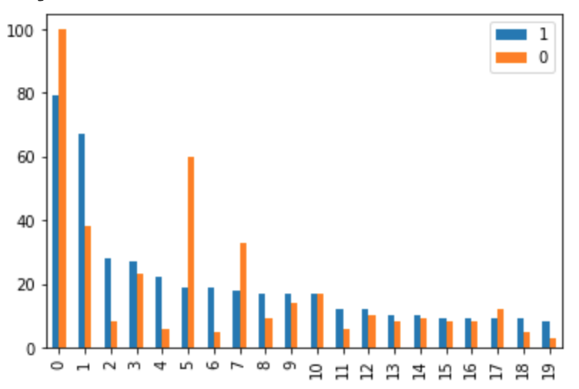
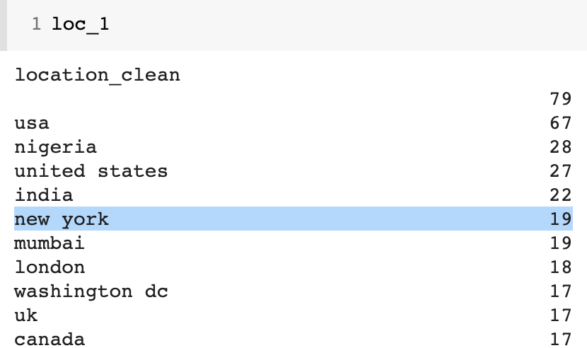
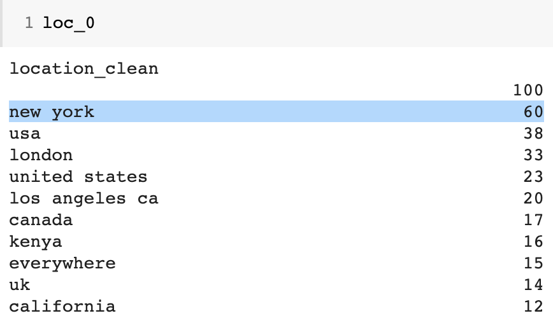
Eins - sortiert
0. No Value (79/100)
USA (67/38)
Nigeria (28/8)
United States (27/23)
india (22/6)
new York (19/60)

Slide 15
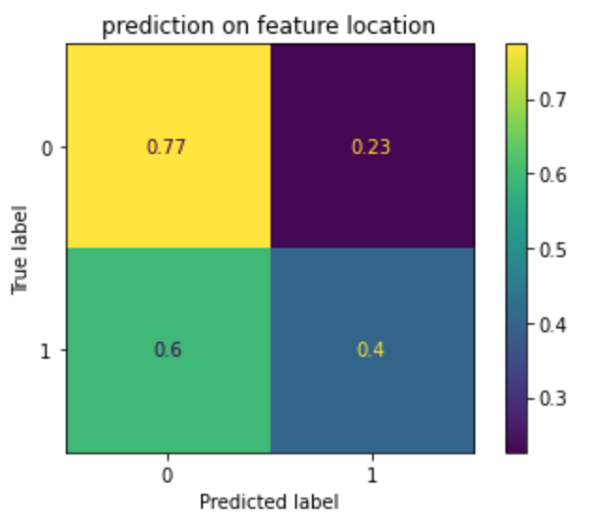
Prediction
Cross_val_Score von 0.5898960911623681
mit (tfidf_vectorizer_loc,LogisticRegression())
tfidf_vectorizer_loc = TfidfVectorizer(analyzer='word',
ngram_range=(1,1))

Slide 16
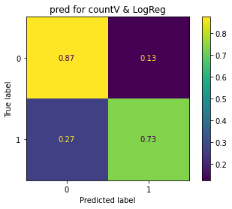
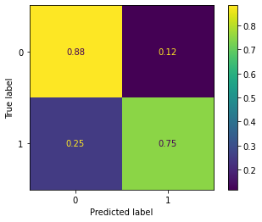
Progress
Day 1: Day 4:
Tfidf + LogReg Classifier
stacking approach:
LogReg, KNN, Naive Bayes
Score Confusion Matrix
0.7898193760262726
0.8260013131976363

Slide 17
Product
Warning App: https://x.thunkable.com/copy/57989626327f283cca1815d081083498

Slide 18
Backup

Slide 19
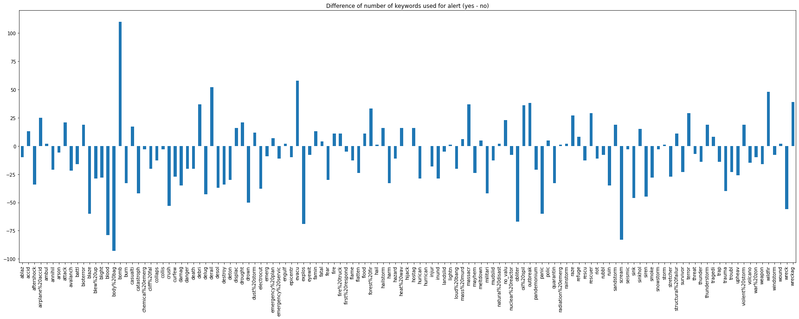
Useful graphs

Slide 20
Used techniques
Data wrangling
regex
replace by dict
POS / NER
ML
pipeline
Tfidf
CountVectorizer
XGBClassifier
stacking
App
thunkable

